Slide 1



Garbha Analytics-Data Driven IVF Outcome Monitoring
The project focuses on analyzing and optimizing IVF clinical outcomes by identifying key success indicators from patient and treatment data, with the objective of improving success rates, reducing clinical variability, and enhancing patient satisfaction through data-driven strategies.

Slide 2
CONTENTS
Business Objective
Business Constraints
Business Problem
Project Architecture - Data Flow Diagram
Data Collection
Exploratory Data Analysis
Data Visualization

Slide 3

BUSINESS OBJECTIVE
To maximize the success rate of IVF / ART procedures by identifying key clinical and biological factors influencing treatment outcomes and enabling data-driven clinical decision-making.

Slide 4
BUSINESS CONSTRAINT
To improve IVF success outcomes while minimizing overall treatment and operational costs, without compromising clinical quality and patient care.

Slide 5
BUSINESS PROBLEM
Rising stress and lifestyle changes have increased IVF demand by 20–30% globally, but overall IVF success rates remain low at 30–35% per cycle. A major contributor is the 25–40% inter-observer variability in embryo grading between embryologists, which leads to inconsistent embryo selection and up to 15–20% loss in implantation potential. Additionally, patients often receive definitive outcome clarity only after 3–4 months, creating delays in clinical decisions and lowering patient satisfaction. These inefficiencies collectively lead to an estimated 10–15% increase in operational cost per cycle and reduce clinic-wide performance visibility across stakeholders.

Slide 6
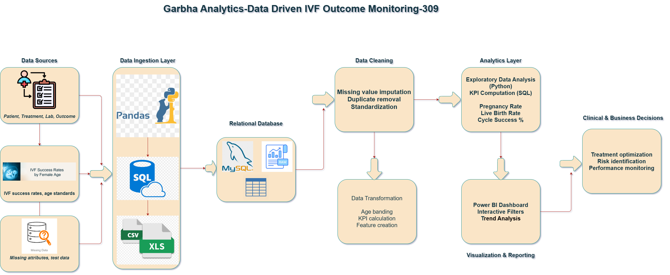
PROJECT ARCHITECTURE – Data Flow Diagram

Slide 7
PROJECT OVERVIEW AND SCOPE
This project focuses on analyzing historical IVF clinical data to monitor, evaluate, and optimize treatment outcomes. The analysis includes patient demographics, age, serum AMH levels, treatment protocols, and clinical outcomes. Using data analytics and visualization techniques, the project aims to identify key success indicators, track performance trends, and provide actionable insights through an interactive dashboard to support clinicians and management in improving IVF success rates and operational efficiency.

Slide 8
DATA DICTIONARY
Field Name | Data Type | Description
Patient ID | Numeric | Unique identifier for each patient
Age (Years) | Numeric | Age of the patient at the time of IVF treatment
Tribe | Categorical | Patient demographic classification
Religion | Categorical | Religion category of the patient
Year | Numeric | Year in which the IVF cycle was performed
Method of Fertilization | Categorical | Fertilization method used (IVF / ICSI)
Stimulation Protocol | Categorical | Ovarian stimulation protocol followed
Serum AMH (pmol/L) | Decimal | Anti-Müllerian Hormone level indicating ovarian reserve
Outcome | Categorical | IVF treatment outcome category
Success Flag | Numeric | Treatment success indicator (1 = Success, 0 = Failure)

Slide 9
Exploratory Data Analysis [EDA]
Mean & Median (Age & AMH Levels)
The mean and median values of patient age and Serum AMH levels are closely aligned, indicating a well-balanced patient distribution with minimal skewness. This suggests that the dataset is representative of the clinic’s typical patient population and allows reliable comparison of IVF outcomes across age groups.
Standard Deviation & Variance
The standard deviation of age and AMH levels shows moderate variability, reflecting natural biological differences among patients without excessive dispersion. This controlled variation supports meaningful outcome analysis and enables consistent identification of high- and low-probability success groups.
3. Skewness & Kurtosis
The distributions of age and AMH levels exhibit low skewness and near-normal kurtosis, indicating fewer extreme outliers. This stability makes the dataset suitable for trend analysis, predictive modeling, and success rate forecasting without distortion from extreme cases.
4. Outcome Spread (Range)
The range of patient age and AMH values highlights a wide demographic coverage. Lower AMH levels and higher age ranges show visibly reduced IVF success rates, reinforcing the importance of patient stratification and personalized treatment planning.
Business Insights
Statistical Insights
Treatment Demand Trend Analysis
Trend analysis of IVF cycles over time indicates a consistent increase in treatment demand, particularly among patients aged 30–40 years. This growing demand highlights the need for scalable clinical resources and proactive capacity planning to maintain service quality and success rates.
2. Outcome Trend & Seasonality Analysis
Age-wise and protocol-wise outcome trends reveal that success rates decline with increasing age, while certain stimulation protocols consistently outperform others. Identifying these patterns enables clinics to standardize best-performing treatment approaches.
3. Forecast Potential
Historical patient demographics and outcome trends enable forecasting of IVF success probabilities. Predictive insights improve patient counseling, expectation management, and proactive clinical decision-making.
4. Optimization Opportunity
Patient segmentation based on age, AMH levels, and treatment protocols identifies high-success and high-risk groups. This enables personalized treatment strategies, reduces repeat cycles, and improves overall clinical efficiency.

Slide 10
DATA PREPROCESSING
Data Ingestion: Loaded IVF clinical data from .xlsx files into Python dataframes and SQL tables.
Data Cleaning: Standardized column names and corrected inconsistent demographic and clinical entries.
Data Type Standardization: Converted Age to integer, Serum AMH to decimal, and outcomes/protocols to categorical fields.
Missing Value Treatment: Applied median imputation for numeric variables to preserve data distribution.
Outlier Identification: Used IQR method to detect outliers in Age and AMH (retained to preserve clinical variability).
Statistical Moments: Computed mean, median, mode, variance, standard deviation, skewness, and kurtosis.
Feature Engineering: Created age bands, AMH categories, and success flags for trend and segmentation analysis.
Normalization & Scaling: Applied Standard Scaling and Min–Max normalization for advanced analytics.

Slide 11
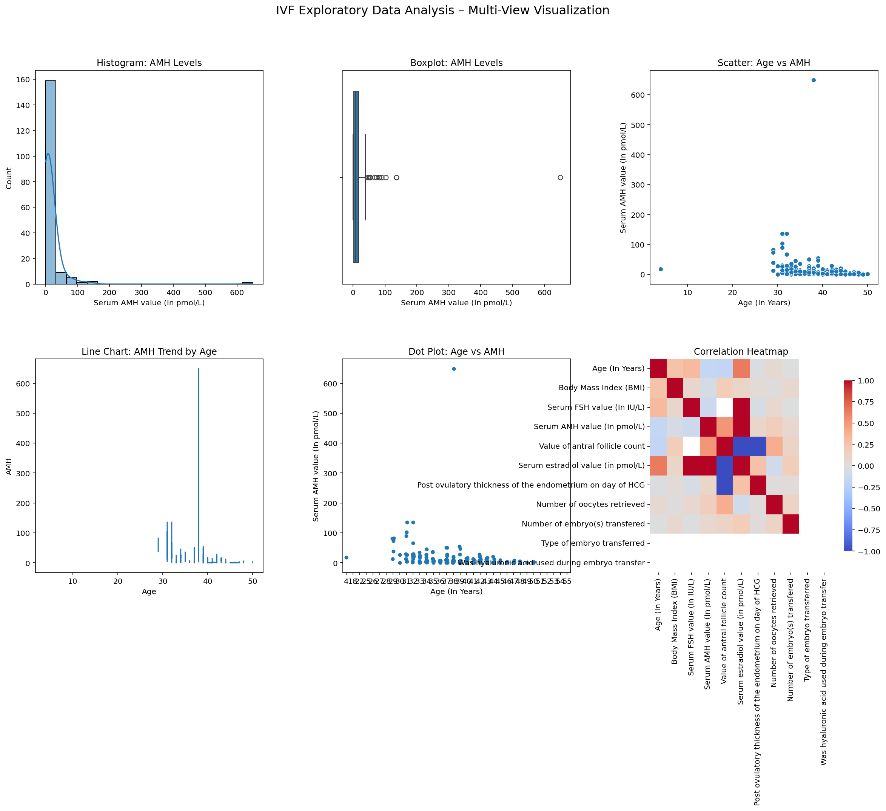
Data Visualization
Heat Map, Line Chart, Histogram and Boxplot

Slide 12
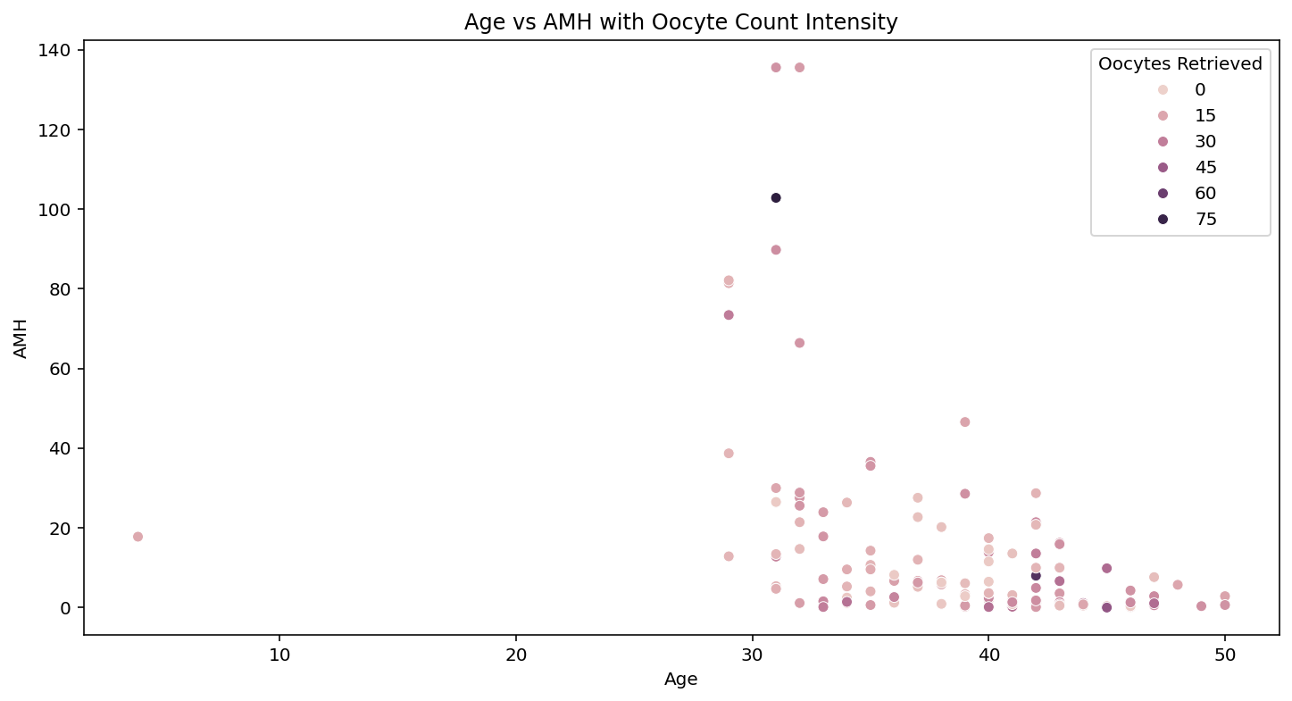
Data Visualization

Slide 13
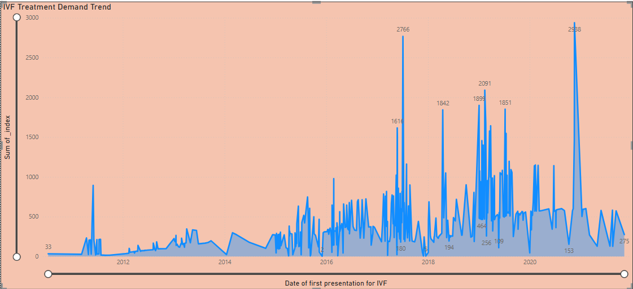
Data Visualization
TREATMENT DEMAND TREND ANALYSIS
Insight -IVF demand shows a steady increase over time, indicating growing treatment adoption.

Slide 14
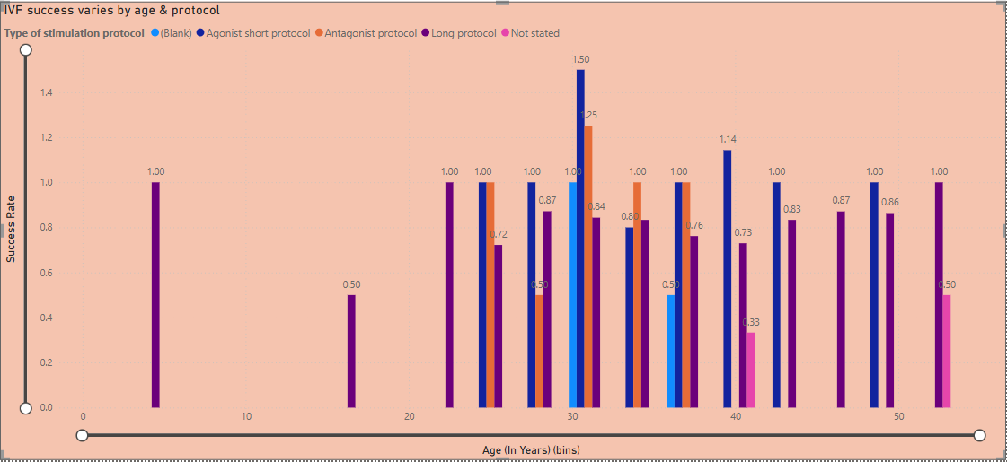
Data Visualization
OUTCOME TREND ANALYSIS Insight-Success rates decline with age and vary across stimulation protocols.

Slide 15
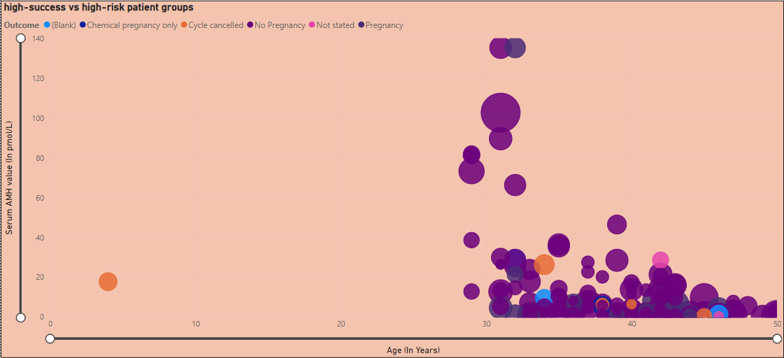
Data Visualization
OPTIMIZATION OPPORTUNITY Insight-Younger patients with higher AMH show better outcomes, enabling treatment optimization.

Slide 16
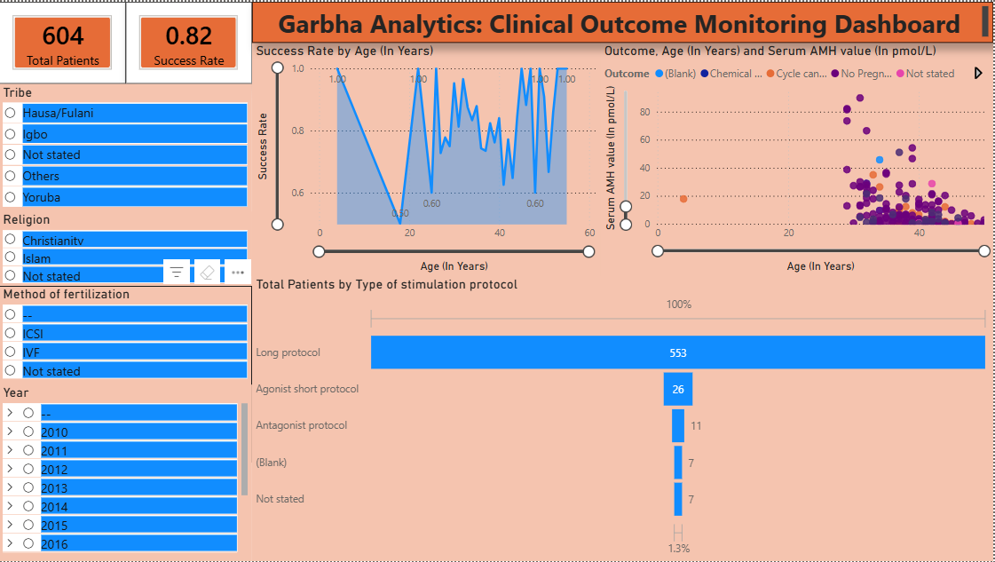
Data Visualization - Power BI Dashboard

Slide 17
CONCLUSION
The IVF Clinical Outcome Analysis Project has established a strong analytical and operational foundation to improve treatment success rates and clinical decision-making. Through a combination of outcome trend analysis, patient segmentation, and predictive insights, the clinic is now equipped to enhance treatment effectiveness, optimize clinical workflows, and improve patient satisfaction.
Established data-driven monitoring of IVF success rates
Enabled predictive analysis for treatment outcomes and demand forecasting
Integrated cross-functional insights across clinical, laboratory, and operational teams

Slide 18


